Slide 1
PERSONALITY TYPES

Slide 2
BACKGROUND
Working with people is part of engineering.
Understanding personality types will help improve leadership and communication.
Understanding that people value different things will help facilitate meetings. For example, a hardcore democrat will rarely convince a hardcore republican about their ideas. Similarly, a hardcore scientist will rarely convince a hardcore religious person about their ideas, because everyone values different things.
It’s important to optimize communication based on what people value. For example, keep the material high level when speaking with managers.
Conflicts are often the result of misunderstanding instead of actual disagreement.

Slide 3
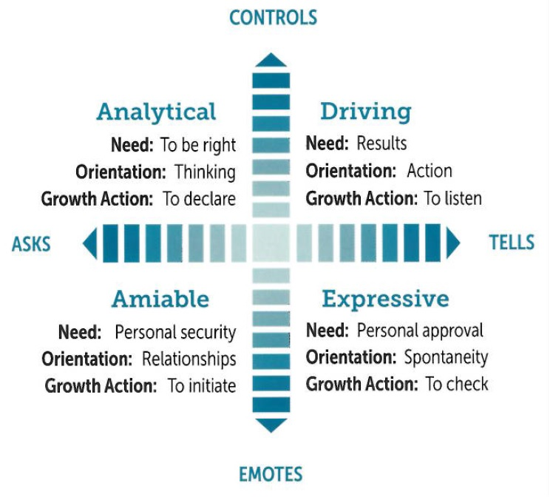
THE 4 PERSONALITIES
There are 4 personality types:
Drivers
Analyticals
Amiables
Expressives
Going north, decisions are based on data. Going south, decisions are based on emotions.
Going right, you like telling people what to do. Going left, you like asking people what to do.

Slide 4
THE 4 PERSONALITIES
style= | drivers | analyticals | expressives | amiables
focus= | budget schedules | innovation accuracy science | impressing others influencing | friendship helping others
typical occupation= | management entrepreneurship | engineering medicine | sales marketing | teaching nursing
salary= | $$$$ | $$$ | $$ | $
key example= | Rockefeller Westinghouse Capone | Tesla Elon Musk Bill Nye | Trump Bilzerian Reality Tv | mr.Rogers Bob Ross

Slide 5
COMMON DELUSIONS
A manager who doesn’t want to spend time learning the technicalities of what they are managing and failing to make decisions that are useful to the business.
An engineer who spends time on over-engineering features that are not useful to the customer or gets a kick out of implementing tools that are slowding down the department. Dean Kamen describes these as ‘high-school science projects’.

Slide 6
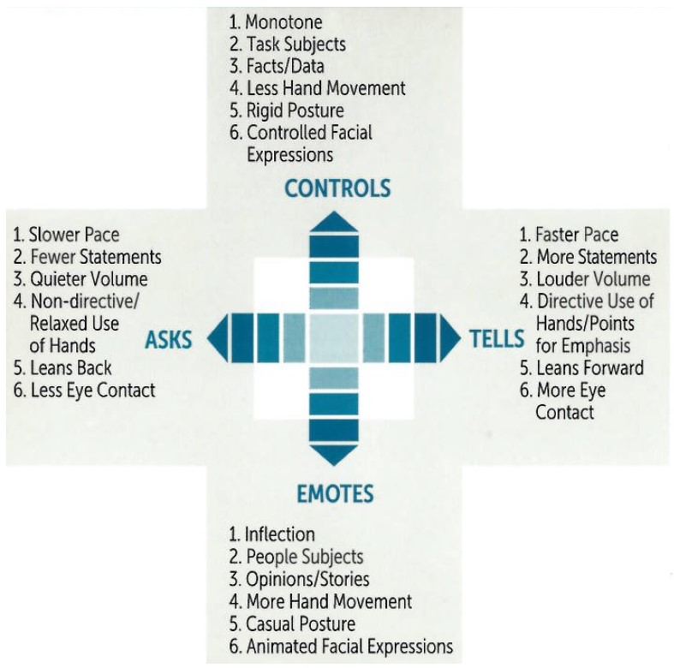
WHICH IS BEST?
There are no right or wrong personality, all 4 are needed for successful business.
Don’t try to be someone you’re not.
Goal is to be in the middle, and not at the extremes.
Goal is to understand all the different personality types and get along.

Slide 7
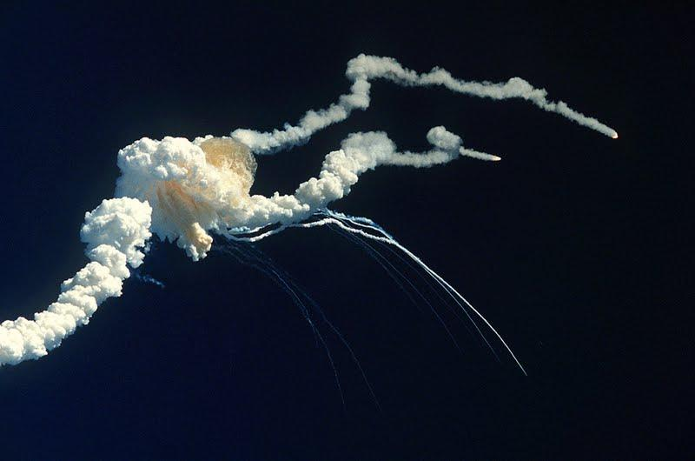
COMMON CLASHES
Analytical versus Driver: 1986 Space Shuttle Disaster: Manager focusing on schedule and engineer focusing on technical o-ring failure before launch.
2012 deepwater horizon spill: Manager focusing on costs and engineer focusing on rig safety violations.
Analytical versus Expressive: Complaining that an advertisement is not accurate and that it’s misleading. Expressive would say that it doesn’t matter if its misleading because at least it looks cool #FyreFestival
Amiable versus Driver: Homestead Massacre of 1892: Henry Frick focused on production at the expense of operator care and safety. Massacre led to the start of the labor union.
Amiable versus Analytical: Staying at home playing video games instead of going out, going to family dinners, and building social skills.

Slide 8
SUCCESSFUL PERSONALITIES
successful | not successful
takes responsibility | assumes someone else will take care of it
is direct | is manipulative
encourages and compliments others | discourages and insults others
gives with no strings attached | gives and secretly expects something in return
forgives easily, learns from their mistakes, and moves on quickly | holds a grudge and dwells on their mistakes
has a sense of humility | takes all the credit and praises themselves
are experimental and open-minded | are afraid to try new things

Slide 9
SUCCESSFUL PERSONALITIES
successful | not successful
can take many hits | will wear out after a few hits
are honest, real, and always true to themselves | are dishonest and fake
are in-control, aware, and calm | are confused, lost, and easily angered
are brave and take calculated risks | are cowards and don’t take risks
they work hard for what they have | barely put any effort for what they want
don‘t assume without knowing | Judge people before knowing them
plans for the next 5 - 10 years | plans for the next 5 – 10 days
are originals | blindly follow orders, norms, and trends

Slide 10
CASE STUDY

Slide 11


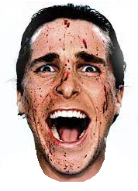
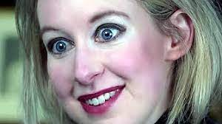
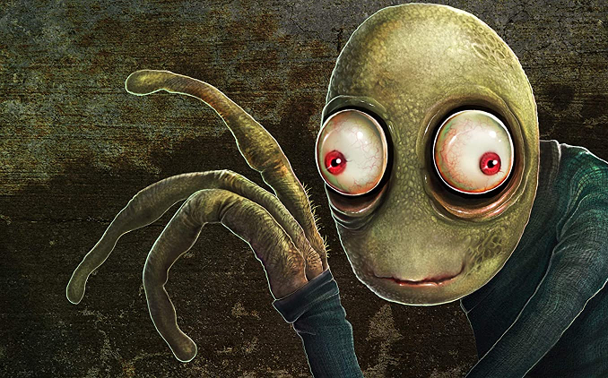

Slide 12
PSYCHOPATHS
Unfortunately, psychopaths aren’t just in the movies, they exist right here in the office, but in subtle forms.
Psychopaths usually hold leadership roles, are power hungry, have inflated egos, have an authority complex, lack maturity, lack compassion towards others, and sometimes have difficulty laughing or smiling.
Psychopaths are often not aware that they are psychopaths.
Their opinion is often the only one that matters, it’s their way or the highway.
Psychopaths will often terminate associates if those associates expose some of their weaknesses. It’s very important to move on from these situations, because a toxic environment is more important than employment.
The Dropout TV series does a good job of portraying what it’s like to work under the leadership of a psychopath.

Slide 13
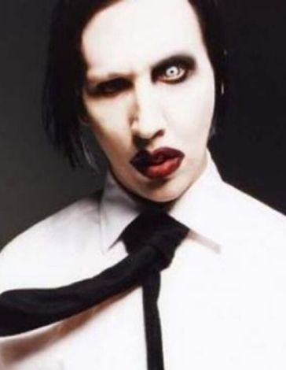
MEET MAX POWERS (TRUE STORY)
Max Powers was articulate and often ‘cried the loudest’ in meetings, which earned him the ranks of software lead to a flagship application.
He often mentioned that he wrote books in software(that never sold), that met the founders of Netflix or Google(that never happened), and that his opinion must always be taken with high regard.
He didn’t have much education besides a GED, but claimed that his self-learning opinions had more weight than an accredited degree.
He changed his name because nobody had the authority to name him, including his parents.
Max did nothing but trash everyone’s code on a daily basis, he rejected everyone’s MRs(merge requests), because they never met his opinionated ‘standard’ of how code should be done and he was surprised no one could read his mind on how to complete code his way.
this is how he actually dressed

Slide 14
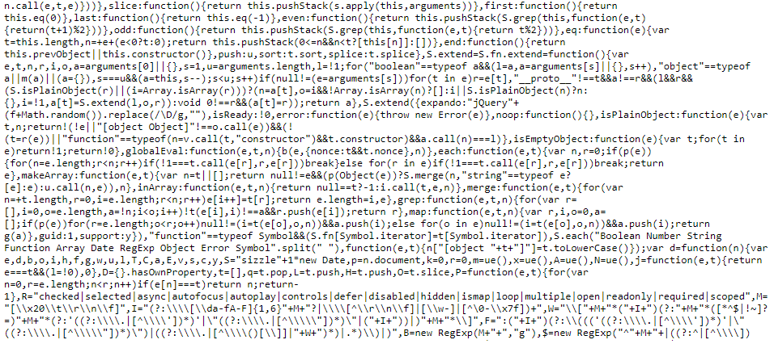
THE PROBLEM
Imagine having Max ask you to fix a complicated bug, that can not be replicated, that comes on and off depending on the day, on a code base that looks like this, oh and on DAY ONE of the job:

Slide 15
THE FRICTION
The problem is not only that you have to solve it without any help but that Max ties your hands further. For instance, he forces you to use a Mac when you request a PC or he forces you to use WebStorm when you are used to using VsCode.
He is controlling to the point where you can not use any technologies that you are used to, pretty much paralyzing you from making any progress.
Max is so bizarre, that he loves people that hate him and hates people that love him.

Slide 16
THE FRICTION
A day later, Max comes up to you and is surprised that you did not solve the bug yet even though Max doesn’t even know how to solve it himself BTW.
But after enough trial and error, you miraculously solve it. You test your code, you commit it, and you wait for it to be reviewed and merged through the MR process.
However, Max pops out of nowhere again and rejects your code. He writes a laundry list of opinionated feedback on why it should be changed. For example, removing comments, using switch statements instead of ternaries, or putting the code in a different component. You realize that he has a ridiculous preference on how code should be done, so you ask to systemize his preferences i.e. always code on the 2nd parent of each pure component, but he is unable to do so. You realize that he has no structure in anything that he is saying, that he is broken, and he is the person writing your reviews of whether you stay employed.

Slide 17
THE FRICTION
In the meetings, he even makes stuff up by saying that writing comments causes memory leaks. Since the Project Managers(PMs) are not tech-savy, they all believe him because Max is articulate.
Max is surprised that you are not coding exactly the way he likes to code. His list is so ridiculous, that you have to set a pair-coding session with him on every MR, and after you make the changes, he continues to reject your MRs for more changes.
You beg to work with anyone but him, and you try to get backup approvers but he doesn’t let you, he only let’s himself be the approver, so the whole dev team has to go through him for code to be merged to master.

Slide 18
INCOMPETENCE GROWS VISIBILITY
At some point, the PMs start to question why there’s no progress being made on the app. The devs have no say in these discussions because they’re not part of the leadership meetings, so Max points the finger at the dev team and says it’s all their fault.
His deception and authority was so bad, that he would even violate corporate HR policies. For instance, he would decline PTO requests unless they were used for emergencies. It’s his way or the highway, and even corporate leadership has no say in his world.
3 devs with 10 YOE left the company for no other reason than because of dealing with him.

Slide 19
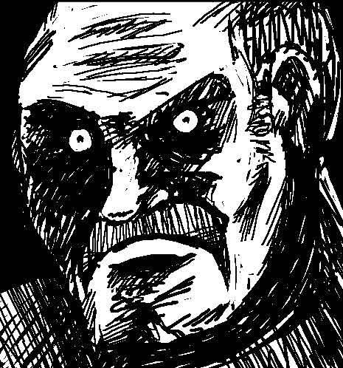
THE TERMINATION
His first and only direct report stayed submissive for months because he knew Max was insane, but one day, he spoke out because the practices of Max was holding up the entire department and could have cost everyone’s job. Max fired his direct report one day after speaking out because that is what psychopaths do when they are exposed.
1 week later, the company realized that Max was the mole and fired him, but at that point, it was too late, because the entire dev team was gone and they were left with next to zero subject matter expertise on the app that was the flagship seller to the corporation.

Slide 20
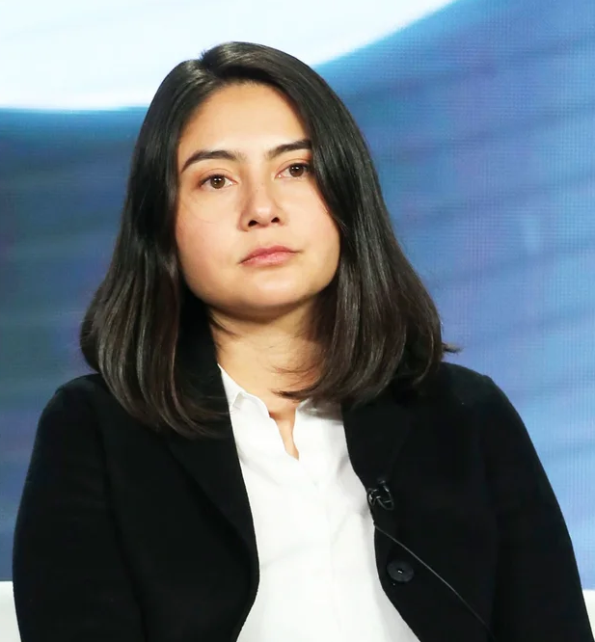
WHISTELBLOWING
Even though the actual value to the company was speaking out and bypassing Max to complete MRs, it cost the dev’s job, and even though making your boss happy was detrimental to the company, it had higher perceived value but low actual value.
Erika Cheung was in a similar situation. She did not want to lose her job or reputation to expose the corrupt practices of psychopath Elizabeth Holmes, but eventually did and successfully took down a billion $ company.
Whistleblowing is not always a good thing, it should be done with caution and only if the practices are truly corrupt. There is a scale of how severe a situation is before whistleblowing is required.

Slide 21
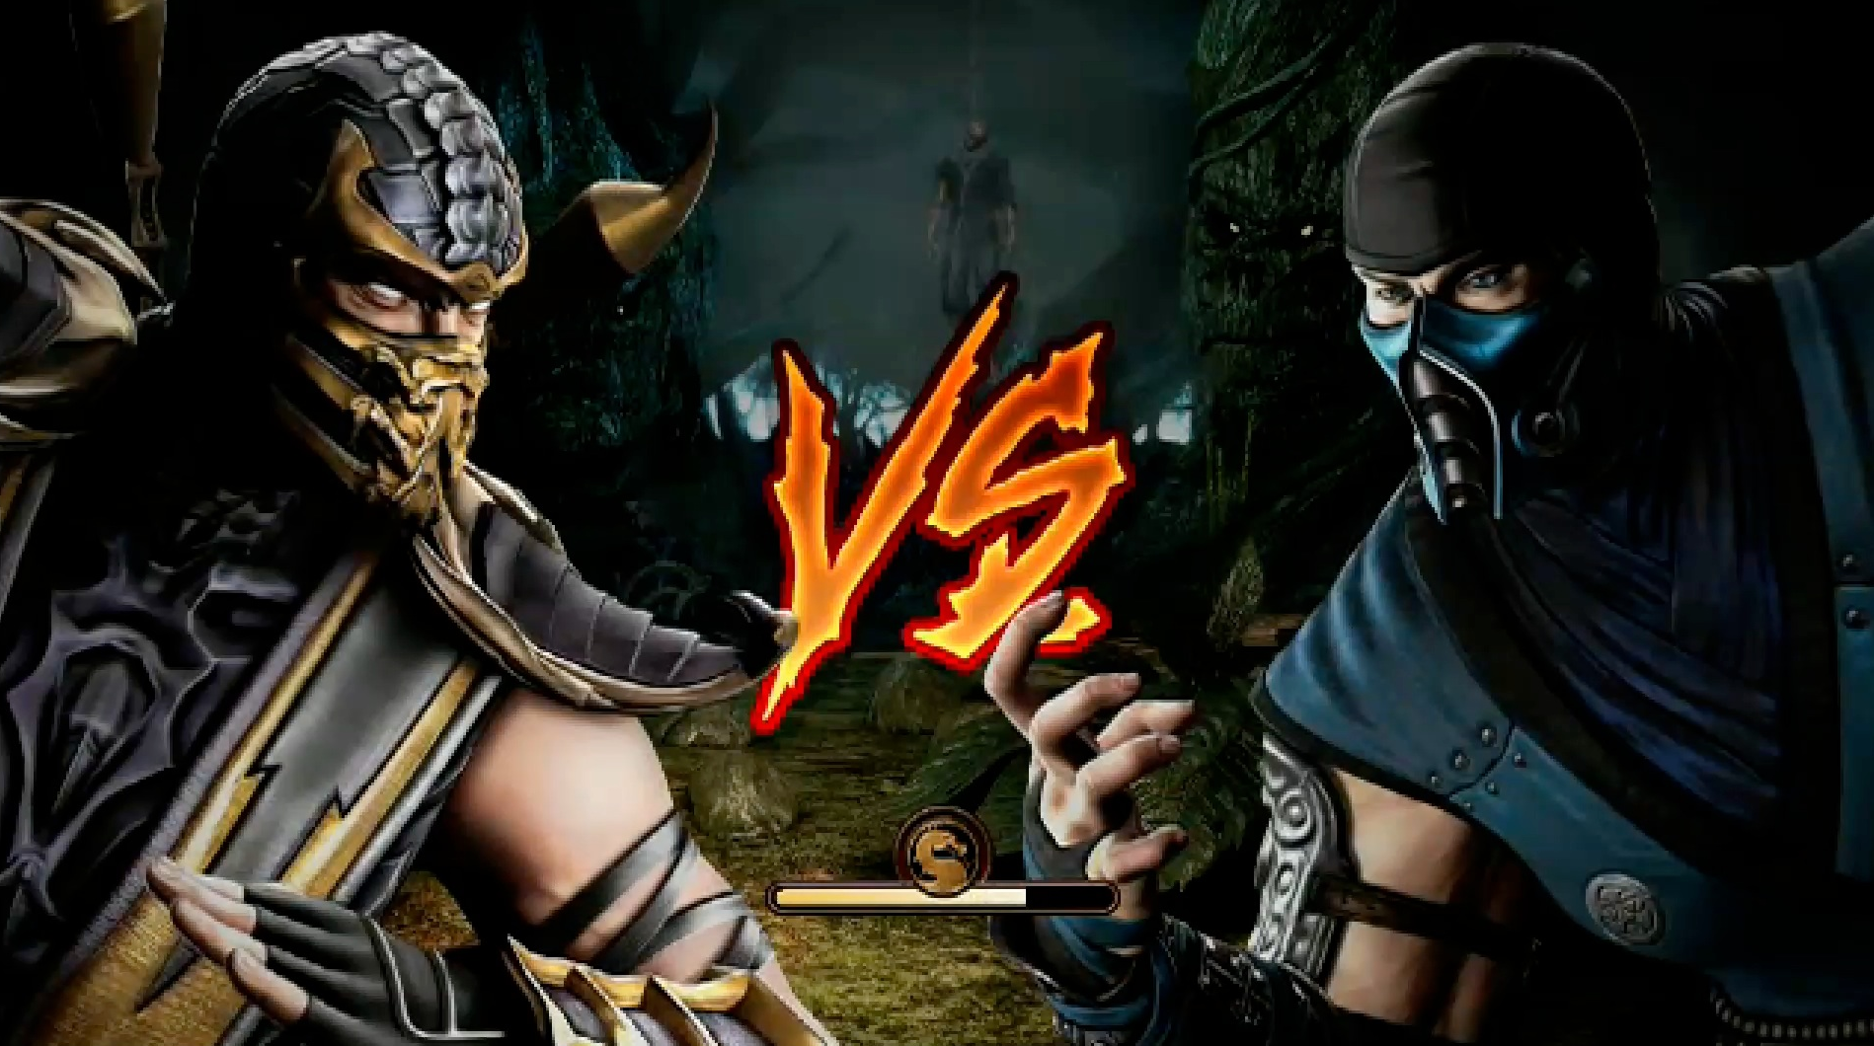
BEST PRACTICE FANATICS
SPAGHETTI
CODERS
BE NEITHER, JUST BE PRAGMATIC!
SEE THE FOREST INSTEAD OF THE TREE!

